Slide 1
Eyes Number And Color Blindness Check Using React Native App And Changing React Js Website Colors An
SlideMake.com

Slide 2
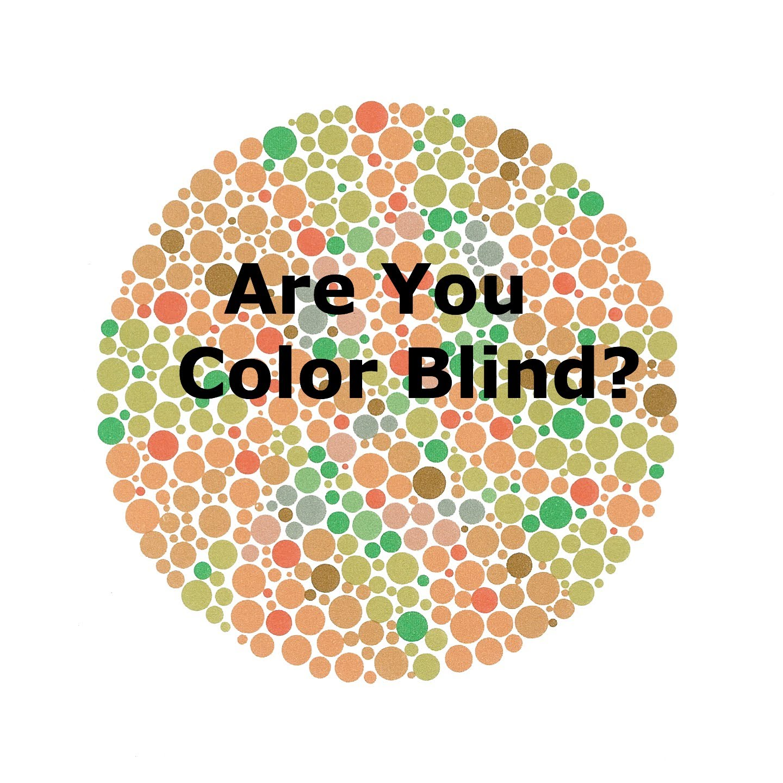
Introduction
Eyes number and color blindness check using React Native App and Changing React js website colors.
This presentation will discuss the implementation of eye number check and color blindness check using React Native, as well as changing website colors using React JS.
These technologies offer innovative solutions for enhancing user experience and accessibility.
Notes:
Image source: http://factsverse.com/10-images-test-color-blind/

Slide 3
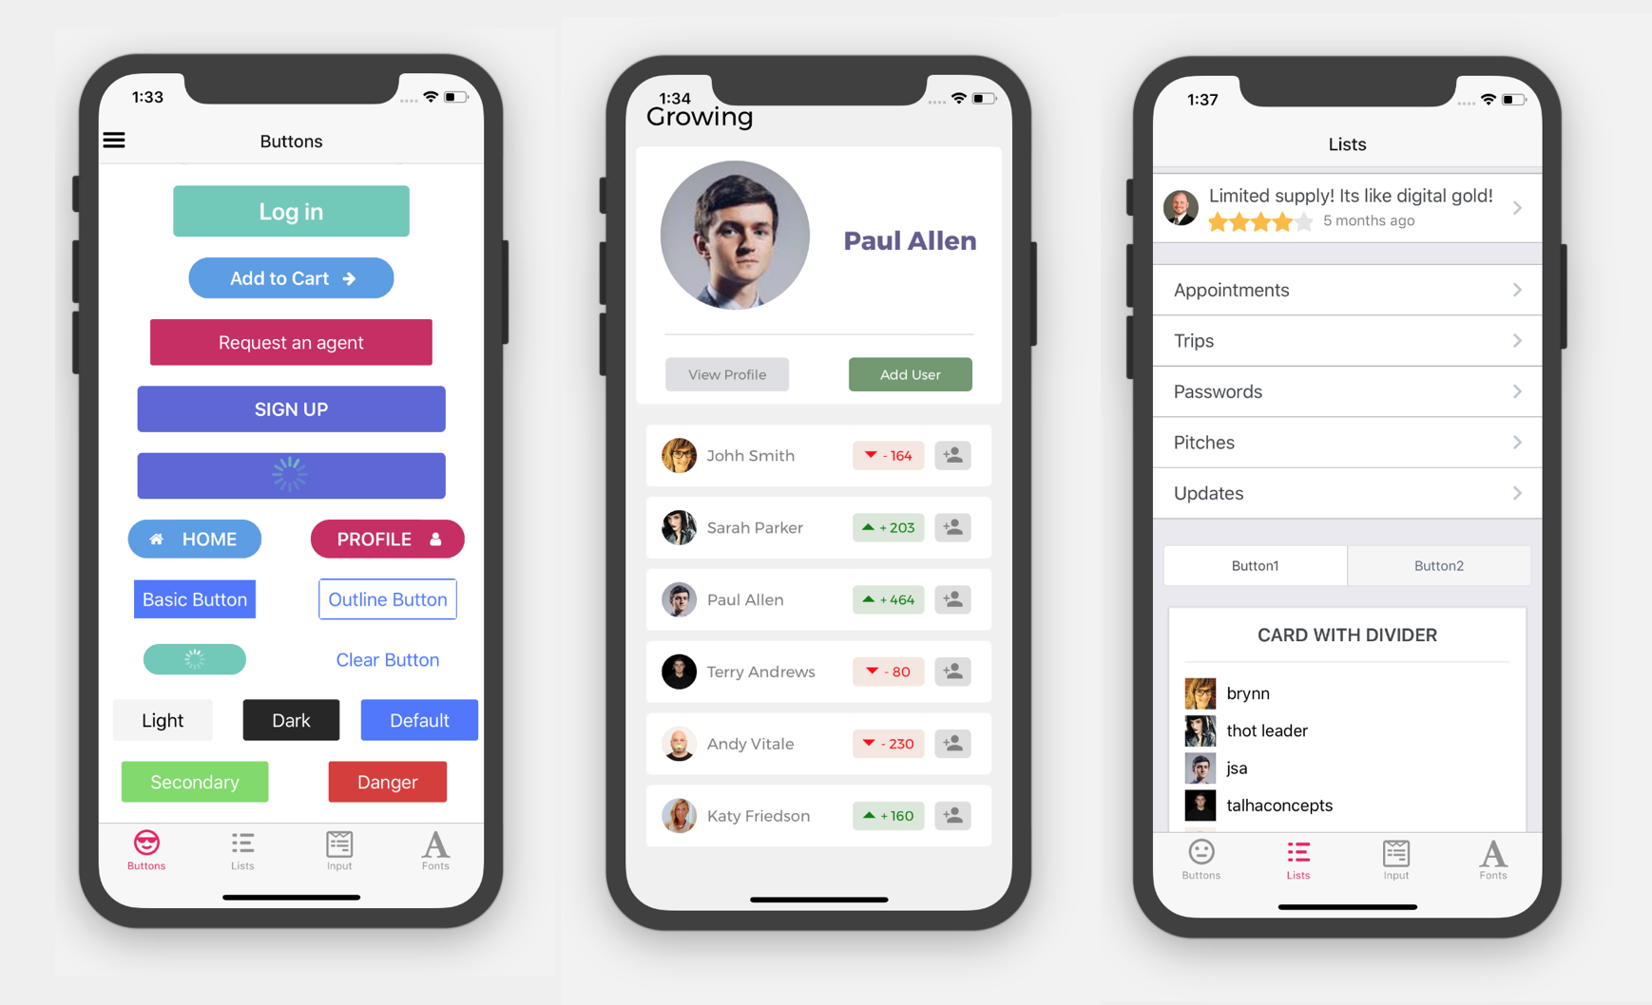
Eyes Number Check with React Native
React Native allows developers to create mobile applications for both iOS and Android platforms.
By utilizing React Native components and libraries, eye number check functionality can be easily integrated into mobile apps.
Users can conveniently test their eyesight through interactive features provided by the app.
Notes:
Image source: https://madewithreact.com/react-native-elements/

Slide 4
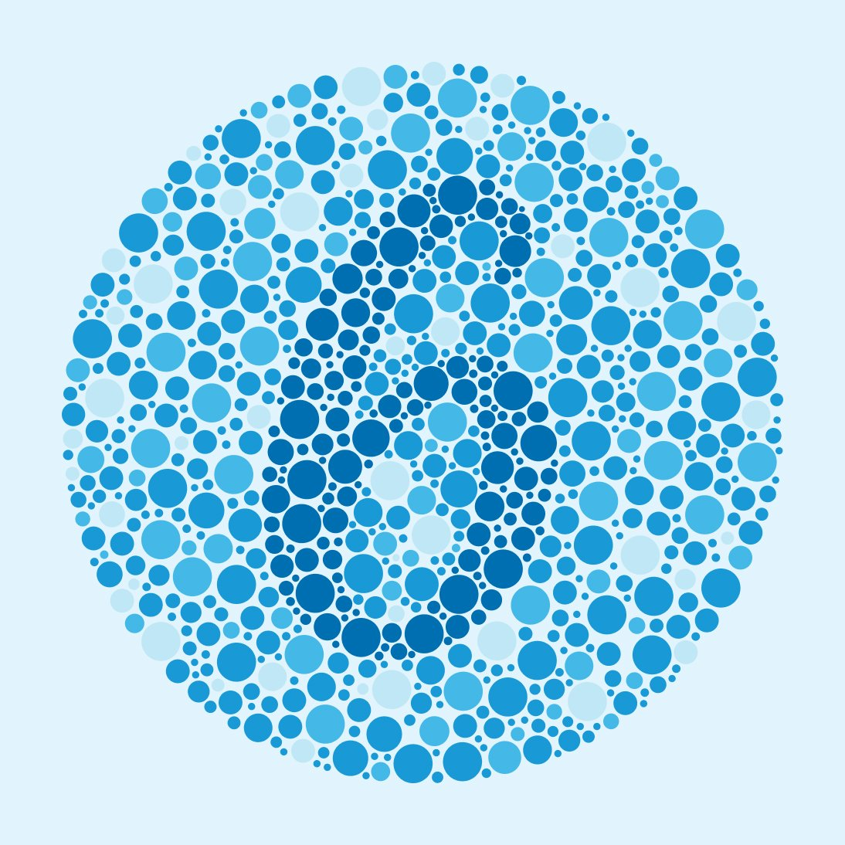
Color Blindness Check with React Native
Color blindness affects a significant portion of the population, making it crucial to incorporate color blindness check features in apps.
React Native enables developers to implement color blindness check tools that help users identify color deficiencies.
By utilizing React Native's flexibility, developers can create customizable color tests for users.
Notes:
Image source: https://www.warbyparker.com/learn/types-of-color-blindness

Slide 5

Advantages of React Native for Eye Health Apps
React Native offers a cross-platform development approach, reducing time and resources required for building eye health apps.
The performance of React Native apps is comparable to native applications, ensuring a seamless user experience.
With a large community of developers and extensive documentation, React Native provides ample support for building eye health apps.
Notes:
Image source: https://www.thirdrocktechkno.com/blog/pros-and-cons-of-react-native-development-in-2021/

Slide 6

Changing Website Colors with React JS
React JS is a popular JavaScript library for building interactive user interfaces.
By leveraging React JS components and state management, website colors can be dynamically changed based on user preferences.
Implementing color theme customization using React JS enhances user engagement and accessibility.
Notes:
Image source: https://www.credencys.com/blog/react-js-components/

Slide 7

Implementing Accessibility Features with React JS
React JS allows developers to create accessible websites by incorporating features such as high contrast modes and color adjustments.
By utilizing React JS's virtual DOM and component-based architecture, developers can efficiently manage website color schemes.
Accessibility enhancements implemented with React JS empower users with varying visual impairments to navigate websites effectively.
Notes:
Image source: https://reactjsguru.com/basic-understanding-of-react-features/

Slide 8

User Experience Optimization with React Native and React JS
Combining React Native and React JS enables developers to create seamless experiences across mobile apps and websites.
By implementing eye number and color blindness checks, developers can enhance user experience and inclusivity.
Leveraging the capabilities of React Native and React JS leads to user-friendly interfaces that cater to diverse user needs.
Notes:
Image source: https://aglowiditsolutions.com/blog/react-vs-react-native/

Slide 9

Future Developments in Eye Health Technology
The integration of artificial intelligence and machine learning algorithms can further enhance eye health apps' diagnostic capabilities.
Collaborations between eye health professionals and developers can drive innovation in creating personalized eye care solutions.
Continuous advancements in technology will lead to more sophisticated eye number and color blindness check features in React Native and React JS applications.
Notes:
Image source: https://auxomedical.com/clinical-integration-artificial-intelligence-look-future/

Slide 10
Conclusion
Eyes number and color blindness check functionalities play a crucial role in promoting eye health awareness and accessibility.
React Native and React JS provide powerful tools for developers to create user-friendly apps and websites with inclusive features.
By prioritizing user experience and accessibility, developers can contribute to promoting eye health and enhancing digital inclusivity.
Notes:
Image source: https://magaretwarner.blogspot.com/2023/11/color-blindness-wikipedia-what-does-it.html

Slide 11

Title
Audience questions and discussions.
Your second bullet
Your third bullet
Notes:
Image source: http://www.mrmediatraining.com/2014/04/08/seven-rules-of-engagement-for-managing-qa-part-one/

Slide 12
References
React Native Documentation: https://reactnative.dev/
React JS Documentation: https://reactjs.org/
"Color Blindness in the Modern World" by John Smith, Journal of Accessibility Studies, 2020.

